Slide 1
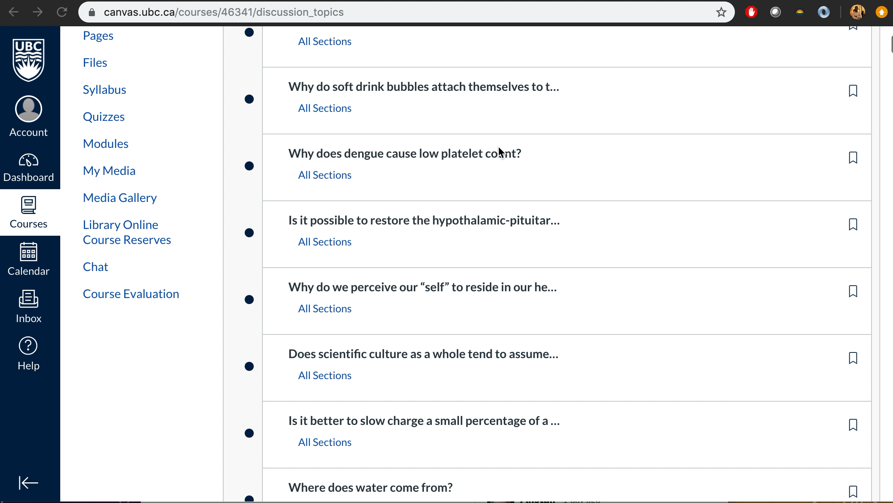

Slide 2
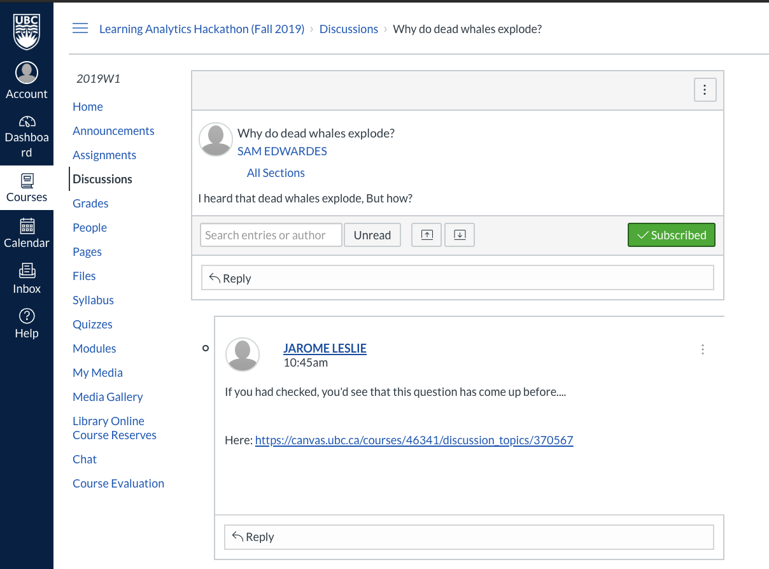


Slide 3
UBC Learning Analytics Hackathon: Improving Canvas Discussion Boards
Muhammad Anas, Alexander Hinton,
Sam Edwardes, Jarome Leslie

Slide 4
Problem
How to make the canvas discussion environment more user friendly and helpful for students
Encourage student participation on canvas in getting their questions asked
Goal

Slide 5
Demo

Slide 6
Areas of improvement
Making the model stricter in selecting threads
Adding tags to threads

